Slide 1
Front End Engineering-I Project
Team Details:
1) Rishab Pahwa : 2210990724
2) Rishabh Jain: 2210990725
3) Rishi Chaudhary: 2210990726
4) Rishi Goyal: 2210990727
Faculty Coordinator:
Dr. Mandeep Kaur
:
Chitkara University Institute of Engineering and Technology,
Chitkara University, Punjab

Slide 2
Table of Contents
Introduction
Problem Statement
Technical Details
Key Features
Project Highlights
Conclusion
References/Links used

Slide 3
Introduction
Title: Note Log
Team Details:
1) Rishab Pahwah : 2210990724
2) Rishabh Jain: 2210990725
3) Rishi Chaudhary: 2210990726
4) Rishi Goyal: 2210990727
Overview:
A Note log is a simple prioritized list of the tasks a person must complete. People make a list of everything they need to do, ranked according to priority from the most critical task at the top to the least critical task at the bottom. Note logs are quickly made entries of the tasks or the atomic entities.

Slide 4
Problem Statement
Traditionally , notes are written on a piece of paper, or post-it notes and do act as memory aids. But as technology has evolved with time, we have been able to create notes using online notepads, applications, spreadsheets, word documents and many more.
Note logs can be used in personal and professional life both , accessed anytime, anywhere with ease.
But sometimes many note making apps are not well organised and make it difficult to organise notes; sometimes notes are not properly synced which creates frustration among users , and the interface that is used is quite boring for the users.

Slide 5
Technical Details
Use of HTML in project:
<html> represents the root of an HTML document.
<head> represents a collection of metadata for doc.
<meta> represents various kinds of metadata that can’t be expressed using title, base, link, style.
<title> represents document’s title or name
<link> allows authors to link their documents to other resources.
<body> represents contents of the documents.
<h1> represents a section heading
<style> allows for quick styling using CSS
<div>element is the generic container for flow content
<ul> represents unordered list.
<li> represents a list item.
<footer> creates footer for the sectioning content.

Slide 6
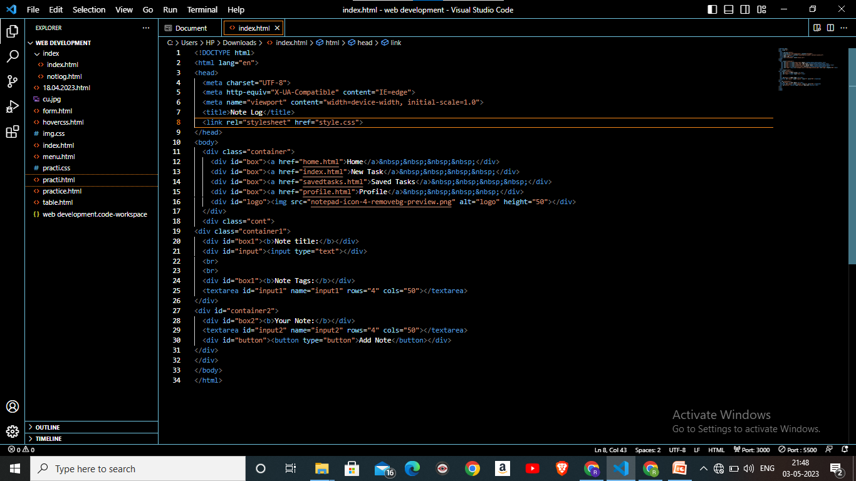
Technical Details

Slide 7
Technical Details 2.0
Use of CSS in project:
Inline and internal css has been used to give a proper layout to our website.
In adjustment of size and margin of images used using background-size, overflow, height, width, background-size , background-position, margin and more.
Horizontal bar containing All, Completed and Not Completed tasks and used different.

Slide 8
Technical Details 3.0
Use of JS in project:
JavaScript is used to make the application interactive and responsive. JavaScript is used to create event handlers, validate user input, and dynamically update the user interface based on user actions.

Slide 9
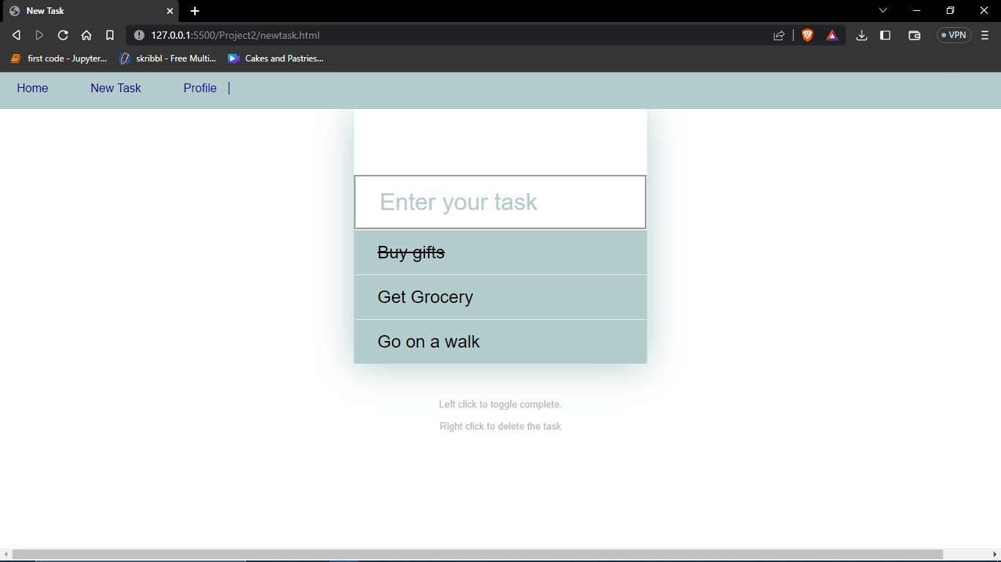
Output
.
.
https://notelog27.netlify.app/

Slide 10
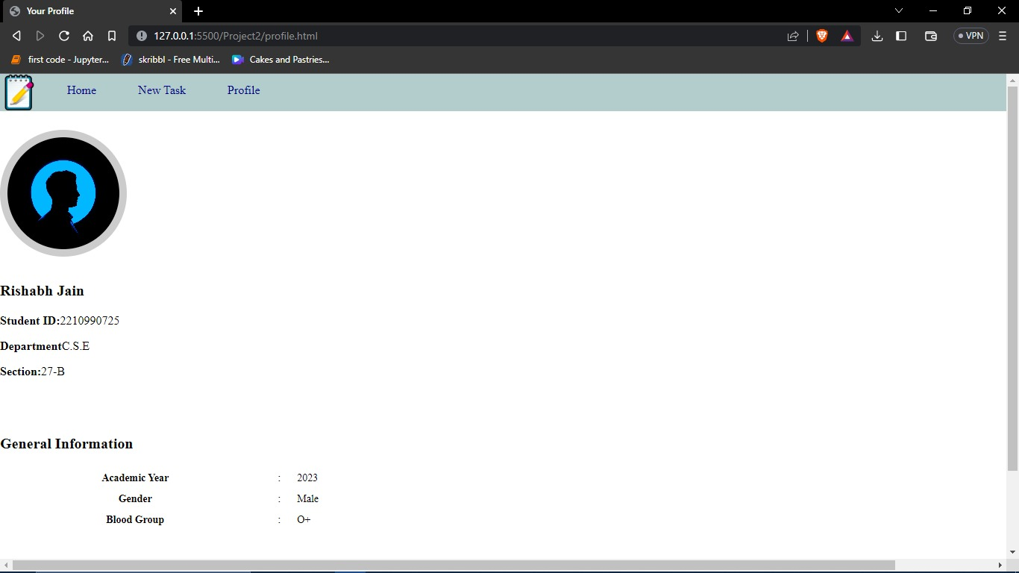
Output
.
https://notelog27.netlify.app/

Slide 11
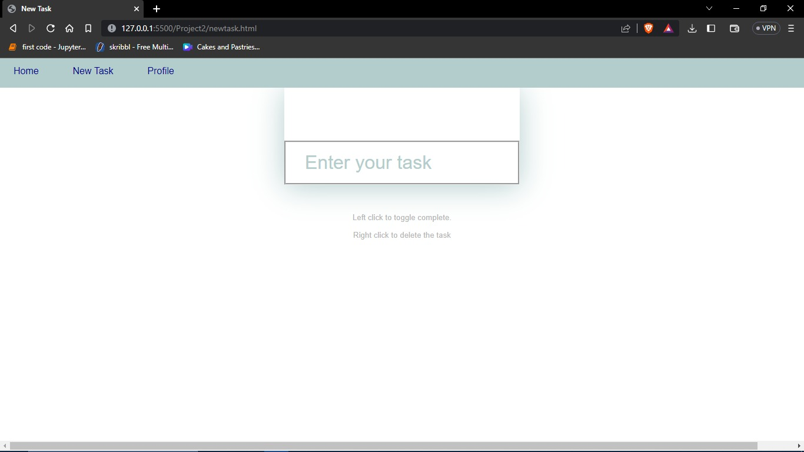
Output
.
https://notelog27.netlify.app/

Slide 12
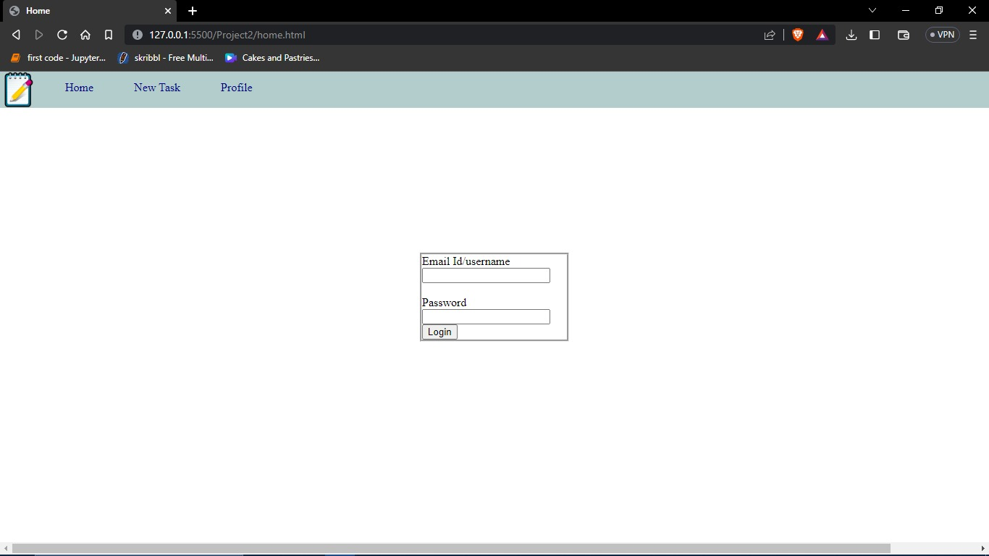
Output
.
https://notelog27.netlify.app/

Slide 13
Key Features
1 ORGANISED NOTES: The webpage NOTELOG makes it easy for the
user to organize their notes orderly , sort which tasks are completed and
incomplete , divide notes into different sections along with date, day
and time of entries.
2 ACCESSIBILITY: Since notes are online, these can be available
Anywhere , anytime with ease.
3 EFFICIENT: Very few resources are required to store and run the webpage.
4 EASY TO USE: The application provides an easy to use , user-
friendly interface which provides addition of notes, notepads, list all
the tasks together, sort completed and incomplete tasks in one-single
click.
5 FREE TO USE: The notelog application is completely free to use and
Can be used by anyone for any purpose (household / professional/
Business etc.

Slide 14
Project Highlights
The Benefits of Using a Note log List: -
Improves your memory: A note log list acts as an external memory aid. It’s only possible to hold a few pieces of information at one time. Keep a note log list and you’ll be able to keep track of everything, rather than just a few of the tasks you need to do. Your note log will also reinforce the information, which makes it less likely you’re going to forget something.
Increases productivity: A note log list allows you to prioritize the tasks that are more important. This means you don’t waste time on tasks that don’t require your immediate attention. Your list will help you stay focused on the tasks that are the most important.
Helps with motivation: note log lists are a great motivational tool because you can use them to clarify your goals. You can divide your long-term goal into smaller, more achievable short-term goals and as you tick each one off your list, your confidence will increase.

Slide 15
Conclusion
1) The feature to rank and list tasks by their priority was implemented towards the end of the project as we had initially planned to classify tasks into two lists only based on whether the tasks were completed or pending.
2) Improvement in security and integrity
3) Integration with other applications such as calendar, mail, location etc.
4)Adding features like storage of data, more convenient organization of user data, make the page more customized.
5)Hosting the web application online to make it accessible to more users.

Slide 16
References/Links used
a) https://en.wikipedia.org/wiki/HTML
b) www.w3 schools.com

Slide 17


